Slide 1

Android Malware Detection Using Genetic Algorithm based Optimized Feature Selection and Machine Learning
DEPARTMENT OF ARTIFICIAL INTELLIGENCE AND DATA SCIENCE
PRESENTED BY:
GUIDED BY :
S.VENKATA NITHYA SREE – (218H1A5449)
L.DIVYA -(218H1A5431)
M.VENKATA SAI REDDY - (218H1A5436)
M.GOWTHAM KUMAR - (218H1A5437)
E.KULDEEP -(218H1A5435)
Mrs.P. NAGENDRA
M.Tech
Notes:
https://www.freepik.com/free-photo/futuristic-technology-screen-interface_7136702.htm#page=1&query=cyber&position=0

Slide 2
CONTENT
Abstract
Introduction
Existing System
Proposed System
System Requirements
1.Software Requirements
2.Hardware Requirements
System Design
Algorithms
Modules
Results
Conclusion
Future scope
References

Slide 3
ABSTRACT
Android is the most popular operating system in the world, but because of its open-source nature and large user base, it is a major target for cybercriminals. These attackers spread malware (harmful software) through malicious apps.
This project presents a smart way to detect Android malware using machine learning. It uses a Genetic Algorithm (an optimization technique inspired by natural selection) to pick the most important features (data points) for identifying malware. These selected features are then used to train machine learning models.
The study compares how well these models detect malware before and after selecting the key features. The results show that the Genetic Algorithm significantly reduces the number of features (by more than half) while still maintaining a high accuracy (above 94%) in malware detection. This not only improves accuracy but also reduces the computational effort needed for detection, making the process faster and more efficient

Slide 4
INTRODUCTION TO PROJECT
Android apps can be downloaded from the official Google Play Store as well as third-party app stores. However, because Android is open-source and widely used, hackers create malicious apps to target users. Even though Google tries to block harmful apps, some still manage to reach users and cause damage. These apps can steal personal information like contacts, emails, and location or even take control of the device remotely.
To protect against such threats, experts analyze these malicious apps through malware analysis, which can be of two types:
1.Static Analysis – Examining the app’s code without running it.
2.Dynamic Analysis – Observing how the app behaves when it runs in a secure environment.
Since new types of malware (zero-day threats) keep emerging, a strong and efficient detection method is needed. Unlike signature-based methods, which require constant updates, a smarter approach can help detect malware more effectively.
Android apps can be downloaded from the official Google is

Slide 5
Existing System
The main focus of this work is to reduce the number of features used for malware detection while still keeping the accuracy high. This is done using a Genetic Algorithm, which helps pick the most important features from a large set. By reducing the number of features to less than half, the machine learning models can train faster and with less complexity.
Instead of testing every possible combination of features (which would take a huge amount of time), the Genetic Algorithm uses a smart searching method based on a fitness function to find the best feature set. This optimized feature set is then used to train two machine learning models:
Support Vector Machine (SVM)
Neural Network
The results show that even with fewer features, the models still achieve more than 94% accuracy while reducing the training time, making the detection process faster and more efficient.

Slide 6
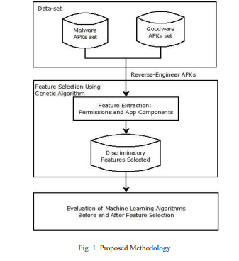
Proposed System
Two set of Android Apps or APKs: Malware/Goodware are reverse engineered to extract features such as permissions and count of App Components such as Activity, Services, Content Providers, etc. These features are used as featurevector with class labels as Malware and Goodware represented by 0 and 1 respectively in CSV format.

Slide 7
Proposed System(cont…)
To reduce dimensionality of feature-set, the CSV is fed to Genetic Algorithm to select the most optimized set of features. The optimized set of features obtained is used for training two machine learning classifiers: Support Vector Machine and Neural Network.
In the proposed methodology, static features are obtained from AndroidManifest.xml which contains all the important information needed by any Android platform about the Apps. Androguard tool has been used for disassembling of the APKs and getting the static features

Slide 8
SOFTWARE REQUIREMENTS
For developing the Application
1. Python
2. Django
3. Mysql
4. Mysql client
5. Wamp Server 2.4
Technologies and Languages used to Develop Python

Slide 9
HARDWARE REQUIREMENTS
Operating System supported by
1.Widndows 10
2.Windows 11
Processor – intel i5
RAM -- 8GB/16GB
Space on Hard Disk -- Minimum 10GB SSD

Slide 10
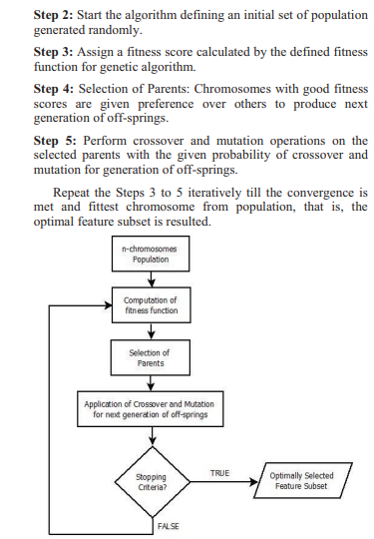
Algorithm
The steps involved in feature selection using Genetic Algorithm can be summarized as below

Slide 11
Modules
#1. Upload Android dataset
#2. Generate Train & test model
#3. Pre-processing
#4. Run SVM & Neural network algorithm
#5.Display Accuracy Graph

Slide 12
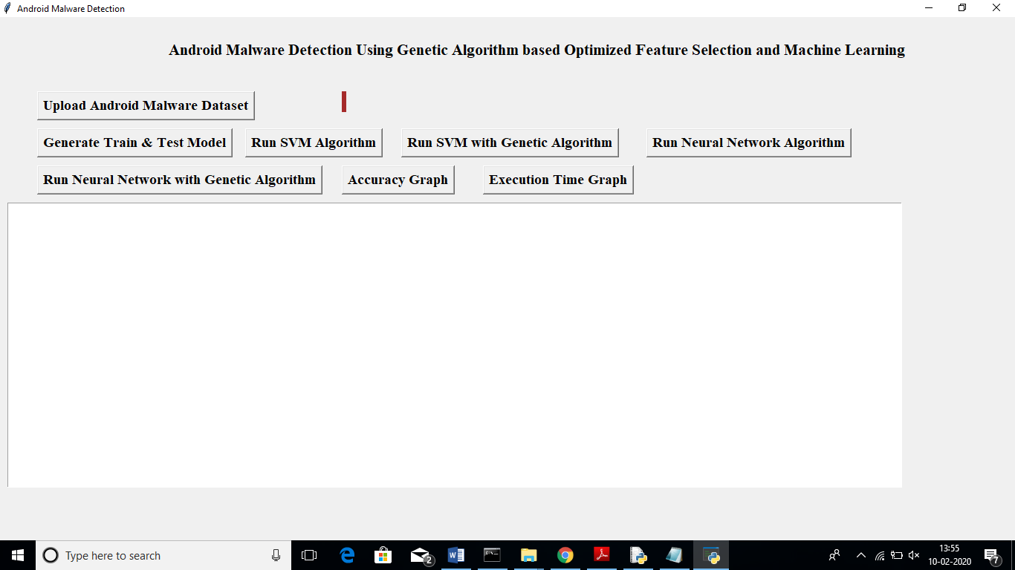
SCREENSHOTS
In above screen click on Upload Android Malware Dataset‘ button and upload dataset.

Slide 13
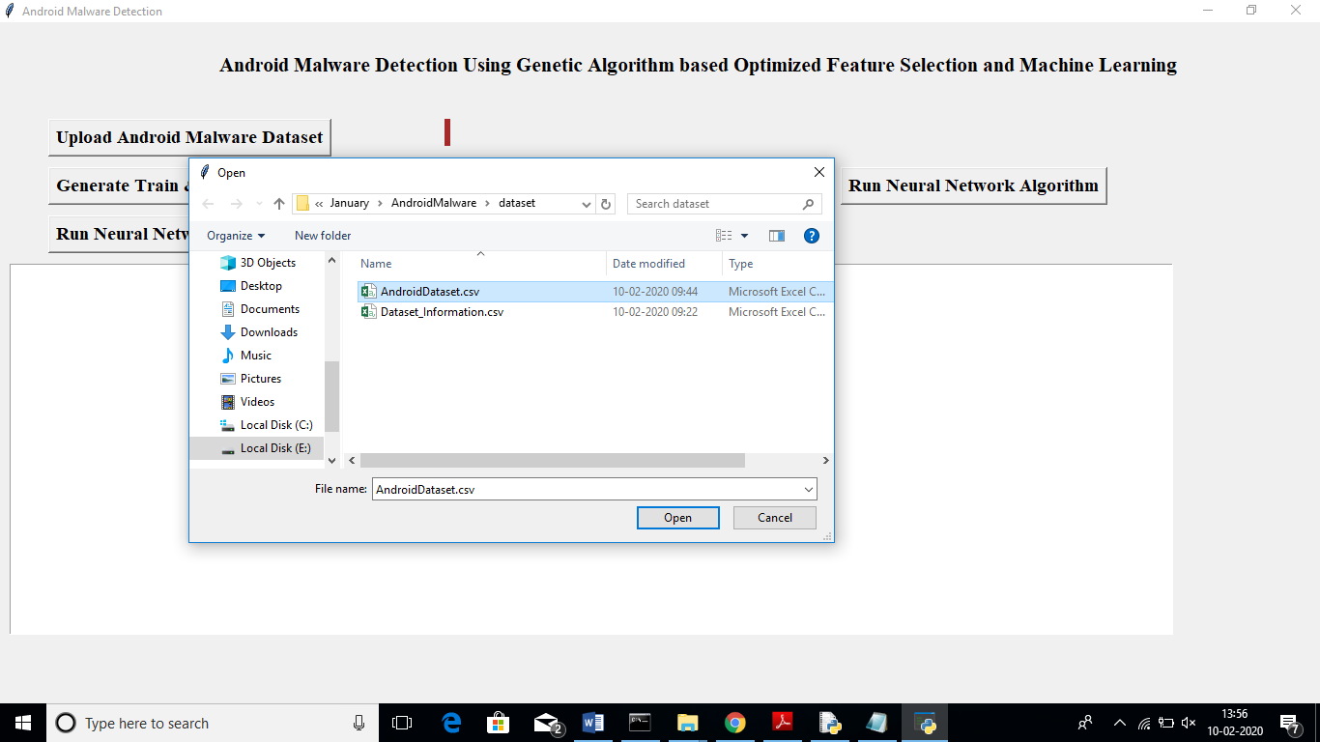
SCREENSHOTS
I am uploading ‘AndroidDataset.csv’ file and after upload will get below screen

Slide 14
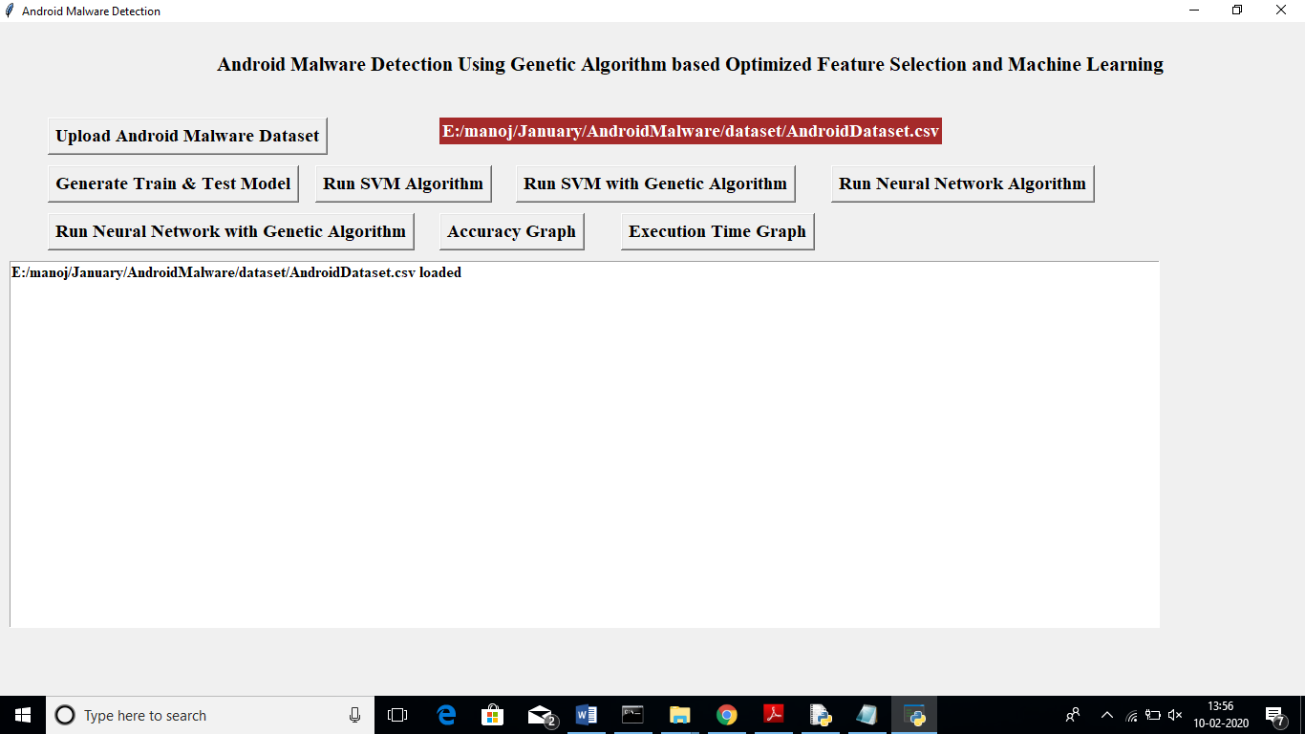
SCREENSHOTS
Now click on ‘Generate Train & Test Model’ button to split dataset into train and test part. All machine learning algorithms will take 80% dataset for training and 20% dataset to test accuracy of trained model. After clicking that button will get train and test model

Slide 15
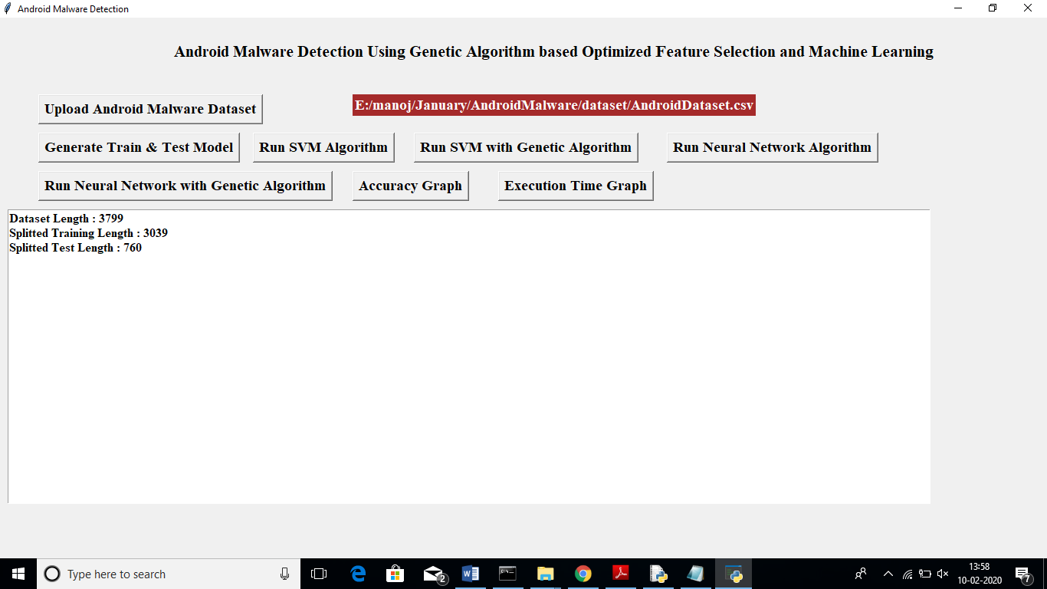
SCREENSHOTS
In above screen we can see there are total 3799 android app records are there and application using 3039 records for training and 760 records for testing. Now we have both train and test model and now click on ‘Run SVM Algorithm’ button to generate SVM model on train and test and get its accuracy

Slide 16
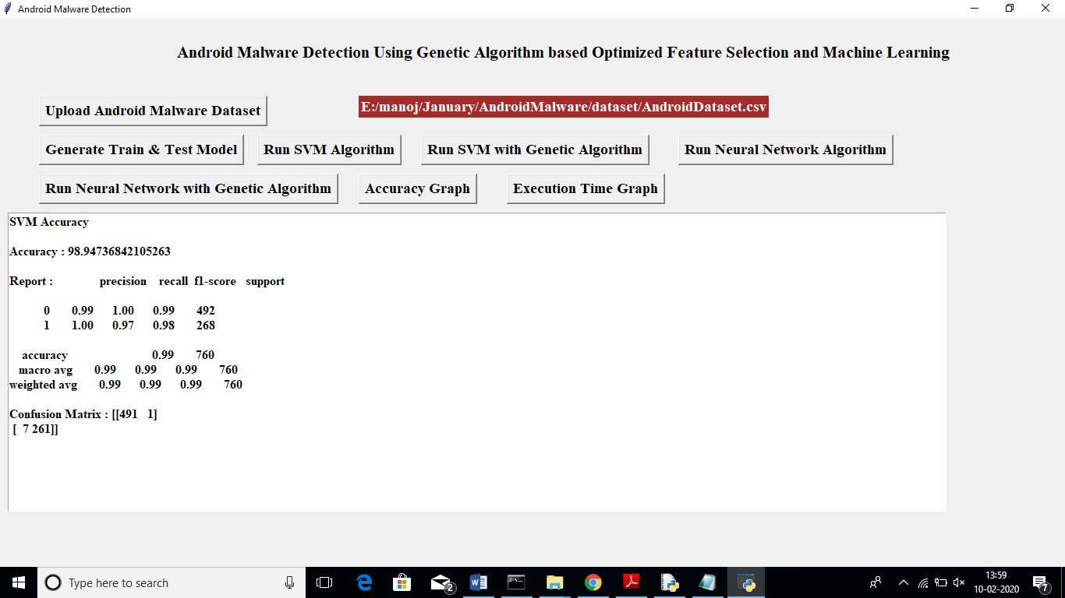
SCREENSHOTS
In above screen we got 98% accuracy for SVM and now click on ‘Run SVM with Genetic Algorithm’ button to choose optimize features and then run SVM on optimize features to get accuracy

Slide 17

SCREENSHOTS
In above screen SVM with Genetic algorithm got 93% accuracy. Genetic with SVM accuracy is less but its execution time will be less which we can see at the time of comparison graph.
(Note: when u run genetic then 4 empty windows will open u just close all those 4 windows and let main window to run)

Slide 18
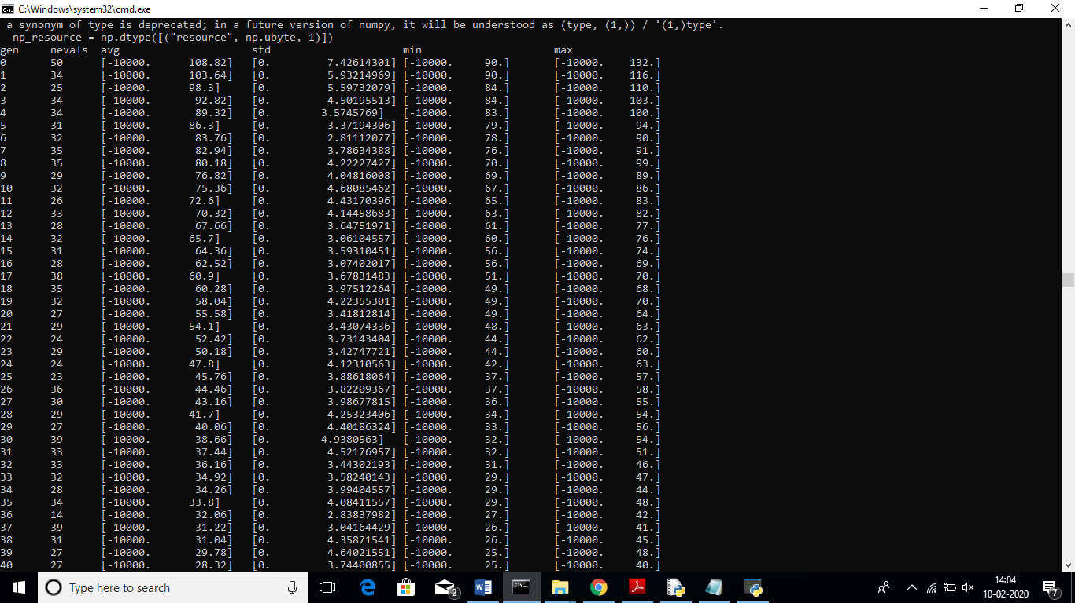
SCREENSHOTS
In above console we can see genetic algorithm chooses 40 features from all dataset features.
Now click on ‘Run Neural Network Algorithm’ button to test neural network accuracy.

Slide 19

SCREENSHOTS
In above screen neural network also gave 98.64% accuracy. Now click on ‘Run Neural Network with Genetic Algorithm’ button to get NN accuracy with genetic algorithm

Slide 20
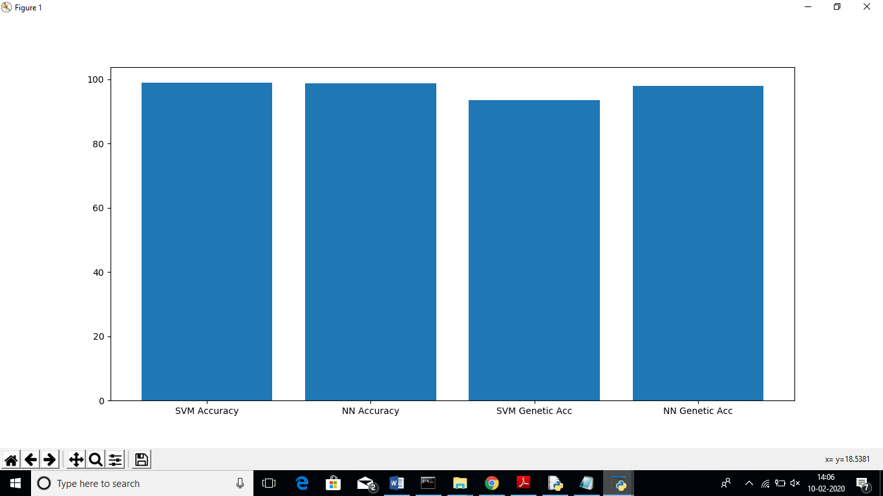
SCREENSHOTS
In above graph x-axis represents algorithm name and y-axis represents accuracy and in all SVM got high accuracy. Now click on ‘Execution Time Graph’ button to get execution time of all algorithm

Slide 21
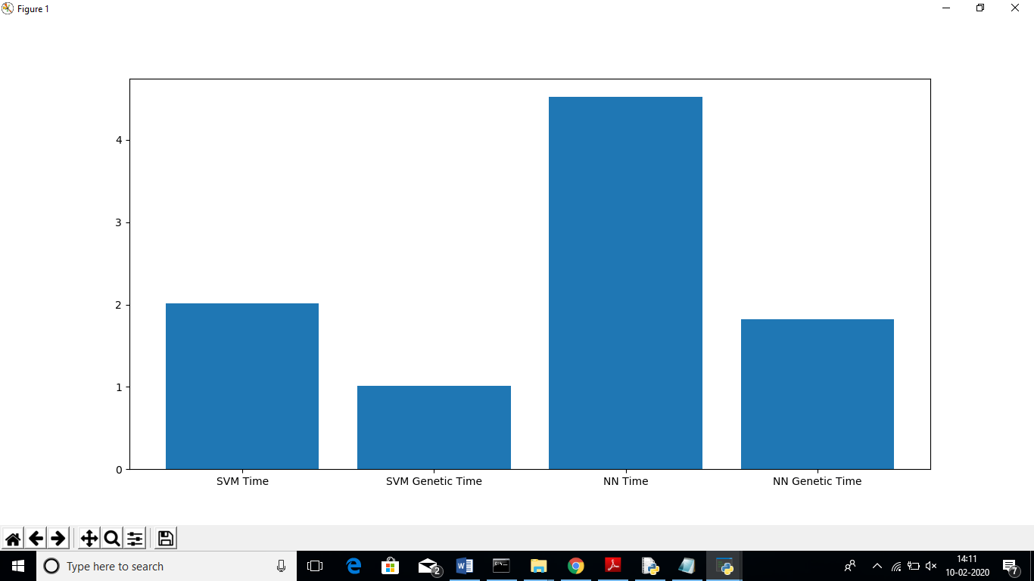
SCREENSHOTS
In above graph x-axis represents algorithm name and y-axis represents execution time. From above graph we can conclude that with genetic algorithm machine learning algorithms taking less time to build model.

Slide 22
SCREENSHOTS
In above screen neural network also gave 98.64% accuracy. Now click on ‘Run Neural Network with Genetic Algorithm’ button to get NN accuracy with genetic algorithm

Slide 23
CONCLUSION
As the number of threats posed to Android platforms is increasing day to day, spreading mainly through malicious applications or malwares, therefore it is very important to design a framework which can detect such malwares with accurate results. Where signature-based approach fails to detect new variants of malware posing zero-day threats, machine learning based approaches are being used. The proposed methodology attempts to make use of evolutionary Genetic Algorithm to get most optimized feature subset which can be used to train machine learning algorithms in most efficient way. From experimentations, it can be seen that a decent classification accuracy of more than 94% is maintained using Support Vector Machine and Neural Network classifiers while working on lower dimension feature-set, thereby reducing the training complexity of the classifiers Further work can be enhanced using larger datasets for improved results and analyzing the effect on other machine learning algorithms when used in conjunction with Genetic Algorithm
Notes:
https://www.flaticon.com/free-icon/spam_927958?term=EMAIL%20SPAM&page=1&position=46

Slide 24
Future Scope
Enhanced Detection: More complex features (dynamic, code-level), hybrid optimization, deep learning integration, explainable AI for transparency.
Evasion Resistance: Better detection of obfuscated/polymorphic malware, robustness against adversarial attacks.
Real-world Impact: Real-time on-device detection, improved cloud analysis, integration into security frameworks, scalable big data handling.
Novel Analysis: User behavior analysis, reputation systems, cross-platform security (IoT).
Key Challenges: Adapting to dynamic features, managing computational cost, addressing dataset bias, balancing interpretability and accuracy.Overall, expect more accurate, efficient, and adaptable Android malware detection systems leveraging the power of genetic algorithms and machine learning to counter evolving threats.
Notes:
https://www.flaticon.com/free-icon/spam_927958?term=EMAIL%20SPAM&page=1&position=46

Slide 25
References
D. Arp, M. Spreitzenbarth, M. Hübner, H. Gascon, and K. Rieck, “Drebin: Effective and Explainable Detection of Android Malware in Your Pocket,” in Proceedings 2014 Network and Distributed System Security Symposium, 2014.
[2] N. Milosevic, A. Dehghantanha, and K. K. R. Choo, “Machine learning aided Android malware classification,” Comput.Electr.Eng., vol. 61, pp. 266–274, 2017.
[3] J. Li, L. Sun, Q. Yan, Z. Li, W. Srisa-An, and H. Ye, “Significant Permission Identification for Machine-Learning-Based Android Malware Detection,” IEEE Trans. Ind. Informatics, vol. 14, no. 7, pp. 3216–3225, 2018.
[4] A. Saracino, D. Sgandurra, G. Dini, and F. Martinelli, “MADAM: Effective and Efficient Behavior-based Android Malware Detection and Prevention,” IEEE Trans. Dependable Secur. Comput., vol. 15, no. 1, pp. 83–97, 2018.
[5] S. Arshad, M. A. Shah, A. Wahid, A. Mehmood, H. Song, and H. Yu, “SAMADroid: A Novel 3-Level Hybrid Malware Detection Model for Android Operating System,” IEEE Access, vol. 6, pp. 4321–4339, 2018.
Notes:
https://www.flaticon.com/free-icon/spam_927958?term=EMAIL%20SPAM&page=1&position=46

Slide 26
THANK YOU
Notes:
https://www.freepik.com/free-photo/business-corporate-protection-safety-security-concept_3533269.htm#page=1&query=cyber%20security&position=0

